Slide 1
Perkins Grant CLNA
Focus Area: Student Performance on Accountability Indicators
June 14, 2023
Chris Lenske
Grant Specialist CTE Team
Jessie Sloan
Data Consultant CTE Team
Notes:
Chris
Good Afternoon.
Welcome to the webcast series on completing the CLNA for the upcoming two-year grant application cycle. Today’s topic focuses on doing your analysis of the Student Performance on Accountability Indicators. The Student Performance on Accountability Indicators is one of the focus areas of the assessment and your Perkins grant application.
My name is Chris Lenske, I’m the grant specialist on the CTE Team. Joining me today is our data consultant Jessie Sloan.

Slide 2
Wisconsin’s CLNA Guide
CLNA Training Series
I. Introduction and Overview of the CLNA requirement
II. Focus Area: Performance on Accountability Indicators
III. Career Pathway Evaluation (including LMI and SSQ)
IV. Educator Recruitment, Retention and Training
V. Focus Area: Equity and Access
V. Putting it all together in preparation for the Perkins application
https://dpi.wi.gov/cte/carl-perkins/grants/formula-grants
Notes:
Chris
We’re conducting a series of training to provide technical assistance for the CLNA process required by the Perkins Act.
If you haven’t watched the Introduction and Overview of the CLNA process webcast, it’ll be most helpful for your team to do that and outline a game plan before everyone leaves for their summer vacations.
The information sets the stage for the CLNA process, team responsibilities, the required activities around reviewing data, and engaging the required stakeholders.
Training for the other focus areas will occur throughout the summer and into fall.
For today’s presentation we’ll be focused on pages 11-14 of the Wisconsin Guide for Conducting the CLNA. I’ve put the link for the guide in the chat https://dpi.wi.gov/cte/carl-perkins/grants/formula-grants
Today we’ll discuss the data that should be reviewed for the Performance on Accountability Indicators focus area; and how to engage stakeholders in your root cause analysis.

Slide 3
Data Driven Decision Making
The Purpose of the CLNA requirement: Data-driven decision making
Determine team
Determine and gather data for the review and format
Determine stakeholders and outreach/engagement strategies
Analysis of data and determine root causes of gaps
Create plan for closing data gaps
Identify goals and develop strategic plan
Identify impactful strategies/activities that will close the data gaps. (Which activities will be supported with Perkins funds?)
Notes:
What is the purpose of the CLNA?
The Perkins V law requires the CLNA to facilitate data-driven decision making on the part of those receiving Perkins funds. Therefor, any instruction, strategies, activities and spending must be driven by what is needed by the agency or consortium to close outcome data gaps.
In other words, any local or Perkins spending reflected in your next Perkins grant application, must be tied to activities that address the root causes of any data gaps.
It is no longer good enough to say, “we’ve always done it this way” or “we believe this activity is good for kids” - especially if what you’re doing is not actually closing any gaps, or moving the bar forward for all student populations.
Where to start? In the last webcast, we went over the importance of identifying your leadership team members, and each person’s roles and responsibilities in the process.
Then determine the data to be reviewed for each focus area, and the best format to view the data. Spreadsheets are not very effective as it’s difficult to visualize comparisons (especially for your stakeholders).
The use of charts or graphs can help to literally draw the picture of what is happening for your different populations and performance indicators.
Choose the stakeholders that can shed light on the “why” there are certain data trends for a given focus area.
Test out the hypotheses presented to confirm what a true root cause for the data gap may be.
Then the team involves the stakeholders further to create a plan outlining priorities, strategies, and activities that everyone believes will be effective in closing the gaps over the next two years.

Slide 4
Focus Area: Progress on Performance on
Accountability Indicators
What are the indicators?
1S1: Four-year Graduation Cohort Rate
1S2: Seven-year Graduation Cohort Rate
2S1: Academic Proficiency in Reading/Language Arts
2S2: Academic Proficiency in Mathematics
2S3: Academic Proficiency in Science
3S1: Post-Program Placement
4S1: Nontraditional Program Concentration
5S1: Program Quality – Participated in Work-based Learning
Notes:
First, let's get grounded in what this focus area is and is not related to.
This focus area deals with your concentrator data that is relevant to the performance indicators you see listed. You will want to disaggregate your data by student groups to see how each student group is performing on each of the listed indicators.
1S1 is the percentage of CTE concentrators who graduate high school,with their four-year cohort with a regular high school diploma.
1S2 is the percentage of CTE concentrators who graduate high school, as measured by the seven-year adjusted cohort graduation rate with a regular high school diploma.
2S1, 2S2 and 2S3 are all about how concentrators are doing in relation to state academic standards laid out in the state’s ESEA plan. For Wisconsin, this is determined by proficiency levels on the ACT test.
2S1 is the CTE concentrator proficiency in the state academic standards for Reading/Language Arts
2S2 is the CTE concentrator proficiency in the state academic standards for Math
2S3 is the CTE concentrator proficiency in the state’s standards for Science
3S1 is related to your post program placement information. This comes from your concentrator follow up survey data as to the percentage of CTE concentrators who, in the second quarter after exiting from high school, are in postsecondary education or advanced training, in the military service, working, or a service program.
4S1 is your percent of NTO pathway concentrators
5S1 is the number of CTE concentrators who graduated with a regular high school diploma having participated in work-based learning at some time during high school.
You’ll notice that three pathway quality elements are not included as an indicator for the purpose of this focus area. They are obtainment of Industry Recognized Credentials; Dual Credit; and participation in CTSOs.
You do not evaluate those things as a part of this focus area, nor should any information about those elements be included in your application for this focus area. Rather, those elements will be evaluated as part of your pathway evaluation of progress focus area.

Slide 5
Data to be Analyzed
• The percentage of CTE concentrators who graduate high school (four-year rate and seven-year rate)
• The percentage of CTE concentrator proficiency in the state academic standards (science, math, reading, and language)
• The percentage of CTE concentrators who, six months after exiting high school, are in advanced training, military service, or employed
• The measure of CTE program quality - participated in WBL
• The percentage of CTE concentrators in CTE programs that lead to nontraditional (NTO) fields
Notes:
So, once again…the data to be analyzed for each of the indicators is the percentage of
CTE concentrator graduates in 4yrs or 7yrs cohorts
CTE concentrator proficiency rates in science, math, reading and language
CTE concentrators who after 6 months following graduation have a positive outcome as listed in the slide
CTE concentrators who participated in WBL as defined in the WBL guide.
CTE concentrators in programs that lead to NTO fields.
Your analysis for this focus area is not about missing the required level on the indicators, though that may be a part of it.
But, it is about disaggregating the data to see where the biggest gaps are, even if you met the minimum performance level. For example, you may have met the NTO indicator level, but when you disaggregate the data for the purpose of the CLNA, you find that while your females are exceeding the minimum level, your males are way below. So, the truth is that your females are helping you to meet the indicator, but male concentration is disproportionately low and is a major gap for you, so this will be an area you’ll want to discuss with your stakeholders including young men as to the root cause and how to address it.
Perkins Accountability Indicators - WISEdash (this is just here in case we get questions. Jessie will address later)

Slide 6
Focus Area: Progress on Performance on
Accountability Indicators
Demographic groups to disaggregate data by:
Race
Ethnicity
Gender
each Special Population group and
each Career pathway
Understanding disaggregated data gaps through easily understandable charts, will help identify where interventions are needed most, facilitate discussions as to the root causes, and potential strategies for closing the gaps most effectively.
10% or more discrepancy
Notes:
To get all of the data you need compiled, work with those responsible for data collection at your agency, to obtain what you need, in an easily reviewable format that allows key trends to stand out. This can be done using the automated pivot tables in WISE as well as the tool for excel spreadsheets.
When we refer to disaggregating data by demographic groups, what are talking about?
We’re talking about breaking the data for each of the indicators out by:
Race
Ethnicity
Gender
each Special Population group and
each pathway to the extent possible
Now, when we refer to special population students, who does that include?
The list can be found on page 13 of the guide.
You should compare your student data for those who are economically disadvantaged, those in the foster care, those with disabilities, English learners, migrant students, homeless students, those with a parent in the military and those girls who are pregnant or parenting. Each group must be looked at to determine where there are gaps to be addressed.
When you look at your data across groups, you’ll see some similarities and some differences between the groups, reflecting either struggles or persistence of student participants and concentrators.
Understanding data gaps at the lowest disaggregated data level will help identify the root causes and potential strategies for closing the gaps most effectively for the population with the biggest gap.
When you compare data across groups, anything over a 10% gap is often considered significant and should probably be looked at closer to determine root causes.
It will help to look at your data using tables and graphs that compare each of the demographic special population subgroups to it’s comparison group.
For deeper analysis, you may disaggregate demographic groups by career pathway. Doing this, will provide a clear picture of which pathways are moving the needle on student performance on accountability indicators and those pathways where barriers may exist.

Slide 7
Data to be Analyzed
Data needed for review can be found in the following locations:
* Indicates the data is located in both WISEdash Public and WISEdash for Districts
Race and ethnicity (*)
Gender (*)
Economically disadvantaged, including low-income(*)
Youth who are in the foster care system (local administrative data)
Students with disabilities (secondary students with IEPs) (*)
English learners (local: home language survey, enrollment in bilingual or ELL program) (*)
Migrant students: (local administrative data and WISEdash Public)
Students experiencing homelessness (self- or staff-reported) (*)
Students with a parent in the active military (U.S. armed services): (Local administrative data and WISEdash Public)
Single parents, single pregnant women (self-reported): (Local admin data and WISEdash for Districts)
Students pursuing nontraditional careers: Identify nontraditional (NTO) pathways by gender, identify students in NTO programs (WISEdash for Districts)
Notes:
Data to be Analyzed comes from a few sources.
This a list of special populations from page 14 of the CLNA Guide. It is meant to assist you with locating data needed to complete the CLNA process.
WISEdash Public is public data that DPI is statutorily required to report about each school district to the public. WISEdash Public data has been redacted to hide student details. That means that group sizes less than 20, have been suppressed or hidden, because of sensitive personal identifying information. So, some of our special populations may be difficult to see in WISEdash Public.
WISEdash for District is an application in WISEhome that houses all school level data reported to DPI. Your district administrator provides access and role assignments to the data. Based on your security role in WISEdash, you will have access to all data sent to DPI. In a couple of slides, I will show you a couple of the WISEdash for District dashboards used for Perkins Indicator data.
On this slide are the individual student populations that you should review and analyze for the CLNA. It is important to review these populations separately, as they each have individual needs when it comes to career education, access, and equity. These populations are not to be lumped together.
An * is used to indicate that the data is located in both WISEdash Public and WISEdash for Districts. This means that WISEdash Public will have general count data displayed about the population. WISEdash for District will allow you to go more into detail and use crosstab features to see which courses or pathways the population is accessing in your district.
A few data points are so sensitive, that we do not include the population in WISEdash for District. For example “youth in foster care” is local data and considered secure data at DPI. I do not even have access to student level data of this population.
If you do not have access to some of these populations in WISEdash for District, it is because of your security role. You can work with your school to identify these students and create a cohort in WISEdash, then apply that cohort to your Perkins dashboard.
You will want to review the performance of these populations within the Perkins Indicators for the past several years, to look for trends. On slide 8, I will show you a spreadsheet to help document your disaggregated data by indicator. This will help you with the inquiry process, discussions and observations, about the data before you do a root cause analysis.

Slide 8
Data to be Analyzed
Where do you get data from for your analysis?
WISEdash Public
Reference A-Z index
WISEdash for Districts
How-to Guides
Perkins Accountability Indicators - WISEdash for District
Accountability Breakdown by Indicator Blank Worksheet
Reference dashboards (Perkins, Topics>Course Enrollment and ACT Statewide)
Notes:
You can utilize WISEdash Public for general data points. But, will primarily use WISEdash for District, to desegregate special populations for each indicator. WISEdash for District is where the December Snapshot is taken and is used to pull your indicator numerator and denominators.
WISEdash Public has an A-Z index to quickly find data points.
WISEdash for District has How-to Guides to assist with navigating dashboards. The How-to Guides are located on the Welcome page within WISEdash and linked here.
Here is also the link to finding the Perkins Accountability Indicators data in WISEdash for District. This slide deck was emailed to CTECs on May 1 and shows you how to look up your numerator and denominator for each indicator in WISEdash for District.
Here is the Accountability Breakdown by Indicator Blank Worksheet that I spoke of 2 slides ago. This will help you with the data inquiry process, before you do the root cause analysis.
These are also the data sheets I use for the Perkins Consolidated Annual Report that is due to the feds in December.
In the next couple of slides, I will show you a blank Accountability Breakdown worksheet and show how to setup WISEdash for District - Perkins dashboard, Course Enrollment, and ACT Statewide.
_______________________________________________________
Resources to reference for your root cause activities
Root Cause Analysis Activities
Perkins Accountability Indicators pdf
Perkins Accountability Indicators Google slides w/notes
ESSA Accountability Reports - pg 7 Academic Achievement Indicator and Business Rules
The Rationale for ESSA The ESSA system is intended to direct attention and supports to where the need is highest. At its core, ESSA’s accountability purpose is to help every state identify the lowest-performing public schools so they can focus on improvement and have the resources to do so. That means that each year, every eligible public school is compared to all the other eligible schools in the state based on five indicators.
GUIDE TO THE ESSA ACCOUNTABILITY REPORT - This is a resource, not your major go-to for analysis. This is your total school population then compare it to you CTE concentrator population found in WISEdash.
Report Cards and Federal ESSA Accountability Crosswalk_2022
Report Cards

Slide 9
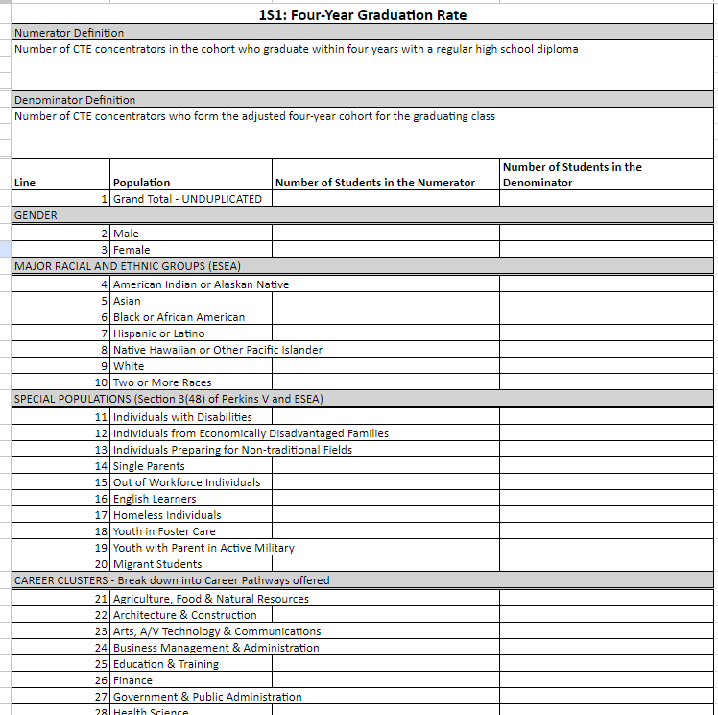
Break down into Career Pathway - IAC Title in WISEdash.
Type the IAC Title into your document.
Notes:
This is one of the Accountability Breakdown by Indicator Blank Worksheets that can be very helpful in examining your data. Each tab in the document is one of the Perkins Indicators.
At the top it informs you of the numerator and denominator definitions, then breaks down by Race/Ethnicity, Special Population, and Career Pathway. Note the heading says Career Clusters-Break down into Career Pathways offered. You want to break down your data into Career Pathways. To get this, go to your IAC Title crosstab in WISEdash. Dig into strengthening each pathways and understanding the size, scope and quality components and how students are accessing them. You may have more than one Career Pathway per Cluster.
Yes, this is a spreadsheet. But you can create trend charts.

Slide 10
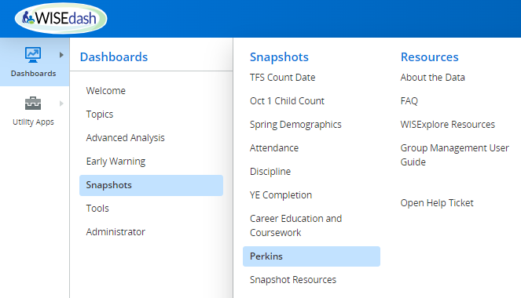
Perkins
Notes:
This is how you access WISEdash for District, Snapshots>Perkins dashboard. This past spring we had a refresh of the menu screen. The dashboard screens all stayed the same.
Follow the blue highlighted area to navigate to the Perkins dashboard.
Also, notice all the Resources available to you in WISEdash for District.

Slide 11
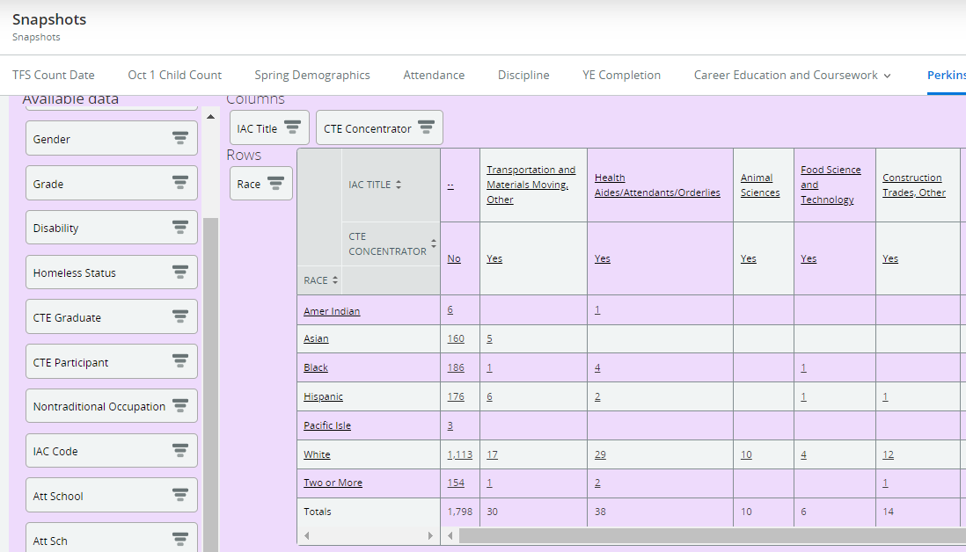
Special Populations
Perkins dashboard
Review of CTE Concentrators by Race and IAC Title
Informs me of the population of students that are accessing Career Pathways…dig into who is/not accessing.
Where do issues with Race pop up?
Notes:
This is from the Perkins dashboard and I cursored down to the “Purple” pivot table. I am using the “Purple” pivot table because we are working with the last Snapshot data from school year 2021-22. The first “green” pivot table is your current year, live data. Current year means 2022-23 or whatever current year we are in. Live data changes, until we have a December Snapshot. The purple pivot table always auto defaults on the last December Snapshot.
In this example, I am looking at CTE Concentrators by Race and IAC Title for career pathways.
IAC Title is your Career Pathways.
If you use the Career Pathway crosstab, it will show Clusters. Schools are sending multiple IAC Titles in a Cluster. Thus, the cluster level may not show an accurate picture of the career pathways you are building and students are accessing.
On the left, I outline in red, other crosstabs of populations that you can add to the pivot table.
This picture is how I like to view columns and rows. You can change the crosstabs to fit your preferred view. Sometimes, I exchange the columns and rows pending on how many IAC Title (career pathways) I see and need them to fit on a single screen, without scrolling.

Slide 12
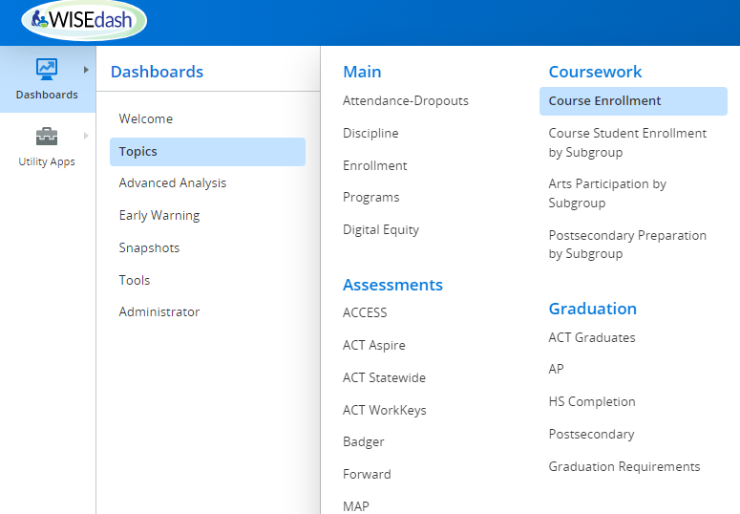
Course Enrollment
Topics dashboard>Course Enrollment
Review populations of students accessing Course Subjects:
CTE areas
Math
Life and Physical Science
English Language and Literature
Notes:
The next 2 slides are to assist you with ACT Statewide results.
To dig into ACT - proficient or advanced results, we also need to look at what types of courses are our Concentrators accessing. This has to do with the data inquiry phase and how we prepare students for the ACT.
In this example, I am setting up WISEdash for Topics>Course Enrollment. Notice that the Topics menu also has the ACT Statewide dashboard.

Slide 13
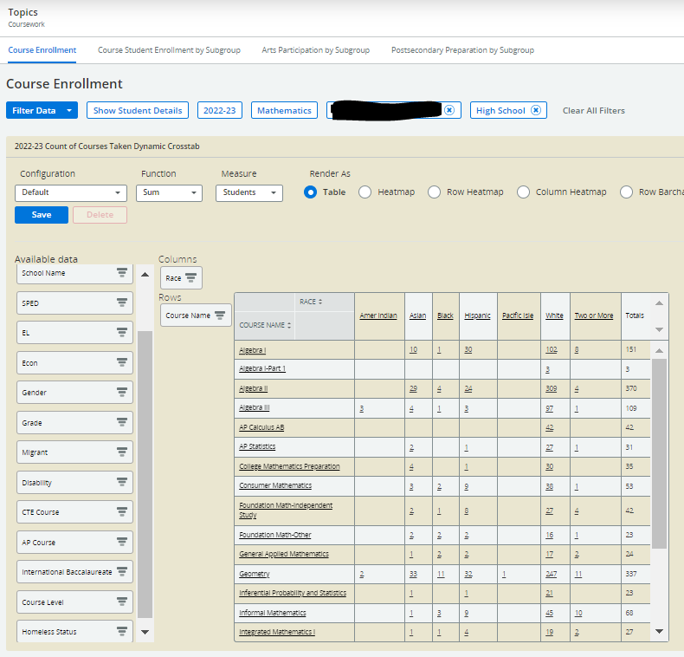
Course Enrollment: Special Populations
Topic dashboard>Course Enrollment
Filter by Course Subject
Create CTE Concentrator Cohort vs. overall population.
What level of coursework do each Race access? (WHY? x 5)
Notes:
This is an example of reviewing all high school math courses in the Topics>Course Enrollment dashboard. I used the filter to show “Mathematics, School, and High School only courses for the 2022-23 SY. I can change the school year, in the Filter Data button. I choose 2022-23 SY year because I wanted to inquire about what math courses my current students took this year.
On the left you can see the crosstabs that can be applied to this pivot table. I start with race because access and equity starts with Race.
You can also use the filter drop down to apply a filter for only CTE Concentrators or build a CTE Concentrator cohort per school year. I have directions on building cohorts in the Perkins Accountability Indicators - WISEdash for District slide deck.
The point of doing this is to review what courses (Math) and high quality curriculum do our CTE Concentrators have access too, to be prepared to take the ACT?
After viewing this data per special population, you will need to write down your observations. This is part of the data inquiry prep work.
Then start the Root Cause Analysis activity of your choice based on your inquiry reflections….for example the 5 Why’s and there are many other types of root cause activities.
Root Cause Analysis Activities

Slide 14
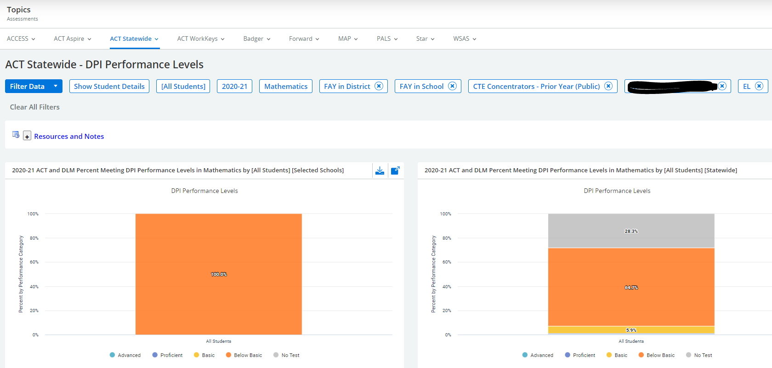
EL 2S2 - ACT Math
Notes:
Jessie
This dashboard is setting up your ACT Statewide - DPI performance levels based on CTE Concentrators. I am showing you the filters that I selected to create this dashboard.
This example is showing 2S2: 12th graders from 2021-22 SY, EL students, who are CTE Concentrators, and took the ACT in 2020-21 as 11th graders on state ACT dates in March.
You can change populations in the filter data drop down menu. You will need to go through your populations to see which populations needs assistance or access to math.
I tried to keep these demonstrations simple. Start with the Perkins Accountability Indicators - WISEdash slides to setup your dashboard views. If you need more assistance, make an appointment with me to view your data. Prior to coming to DPI, I was a District Assessment Coordinator. So, if you need help with understanding any aspect of state testing, reach out for help.

Slide 15
Engage Stakeholders
(1) representatives of CTE programs including teachers, school counselors, principals, other administrators, and specialized instructional support personnel and paraprofessionals;
(2) representatives of CTE programs at postsecondary educational institutions;
(3) representatives of local workforce development boards and local or regional businesses or industries;
(4) parents and students including students from each special population group
(5) representatives of each special population group;
(6) representatives of regional/local agencies serving out-of-school, homeless, foster and at-risk youth;
(7) representatives of Indian Tribes and Tribal organizations in the State, where applicable
(8) any other stakeholders that DPI requires - Regional Career Pathways Collaboratives/agencies
Notes:
Once the data has been pulled and put into understandable visuals with the trends identified, the next step is to engage stakeholders to help you answer the “why?” questions.
Work with a team of stakeholders to get fresh eyes and perspective.
So, take a moment to consider which stakeholders might be important to include for this focus area?
One key stakeholder would likely be those with lived experience in education: such as students, parents, or their representatives and advocates. Also -
Teachers (both CTE and non-CTE) and other school personnel such as the director of instruction, special education, counselors.
District staff serving certain groups of students where gaps are identified such as foster, homeless and EL will have insight as well.
These stakeholders can provide perspective on practices that are impacting disproportionality as well as what needs to change.
Extra eyes will help to figure out solutions faster by offering points of view, challenging assumptions and serve as a check against our own single perspectives or bias.

Slide 16
Analysis - “Questioning the Data”
Questions to “Ask the data”
5 Whys approach - “Ya but, why…?”
“What does that mean?”
“How come?”
“What will have impact to move the bar and reduce or close the gap?”
Test your hypothesis by engaging stakeholders
Notes:
Let’s talk a bit about those “5 Why questions” There are many ways to get to a root cause analysis - but one of the most common techniques is the 5 Whys approach that Jessie mentioned.
In this approach, similar to an annoying toddler, we keep asking, “why”, each time we’re provided with an answer. In other words, not being totally satisfied with the answers given.
For every answer to a WHY question, follow it up with an additional, deeper “Ok, but WHY?” question. Children are very effective at getting to the root cause of their question.
Once you think that you’ve identified the root cause of the problem (and not just another symptom), go on to ask even more questions: What is contributing to that cause? When you find an answer, ask what is contributing to that (why) and on and on. In other words your first or even second or third “reason” is not the real reason for the gap.
The team should ask, “Why are we certain this is the root cause instead of something else?” How have you vetted the hypothesis?
Use simple questions like “how?” or “so what does that mean?” to carve a path towards understanding how the root cause can be fixed to prevent the issue from happening again?
Test your understanding or your hypothesis to see if your on the right track. You can do this by conducting focus groups or a survey with stakeholders.
You CANNOT avoid this activity. And, you cannot do it alone at your desk. You will never get to a root cause or effective solutions if you do that.

Slide 17
The 5 Whys - An Example
“Why do I have such a bad headache?
The first answer might be: Because I can’t see straight.
The second why question: Why can’t you see straight?
The Second answer: Because I my head hit the ground.
Third why: Why did your head hit the ground? Third answer: I got hit tackled to the ground and hit my head hard.
Fourth why: Why did hitting the ground hurt so much? Fourth answer: Because I wasn’t wearing a helmet.
Fifth why: Why weren’t you wearing a helmet? Fifth answer: Because we didn’t have enough helmets in our locker room.
By finding detailed responses to incremental questions, answers become clearer and more concise. Ultimately, the last WHY will lead to a failed process, that can be fixed to make a difference.
Notes:
Here is a very plain example of how to proceed with the “why” questions…
In the example, a football player presents the problem:
“Why do I have such a bad headache?” This is the first WHY question.
The first answer might be: “Because I can’t see straight.” [but this answer alone could take you in a bunch of directions that could be wrong, so follow up with another why]
“Why can’t you see straight?”
The answer: “Because my head hit the ground.” [Ah… this gives us more information - we now know he doesn’t simply need glasses]
The Third why: “Why did your head hit the ground?” Third answer: “I got tackled to the ground and hit my head hard.”
Fourth why: “Why did hitting the ground hurt your head?” Fourth answer: “Because I wasn’t wearing a helmet.”
Fifth why: “Why weren’t you wearing a helmet?” Fifth answer: “Because we didn’t have enough helmets in our locker room.”
Aha! After these five questions, we discover that the root cause of the concussion was most likely from a lack of available helmets (we could ask more questions… are there not the right sizes available, is there a lack of funds…) So, now - what to do about it? In the future, one way to reduce the risk is by making sure that every football player has a helmet by doing xyz.
So, you see, the first “answer” was not the root cause of the problem. The “5 Whys” serve as a way to avoid assumptions, which, is where our minds first jump to.
By finding detailed responses to incremental questions, answers become clearer and more concise each time. Ideally, the last WHY will lead to something in the system that failed; one which can then be fixed.
There is further-more in-depth training provided to you and your teams through WISE Explore.
Other Root Cause Analysis Activities

Slide 18
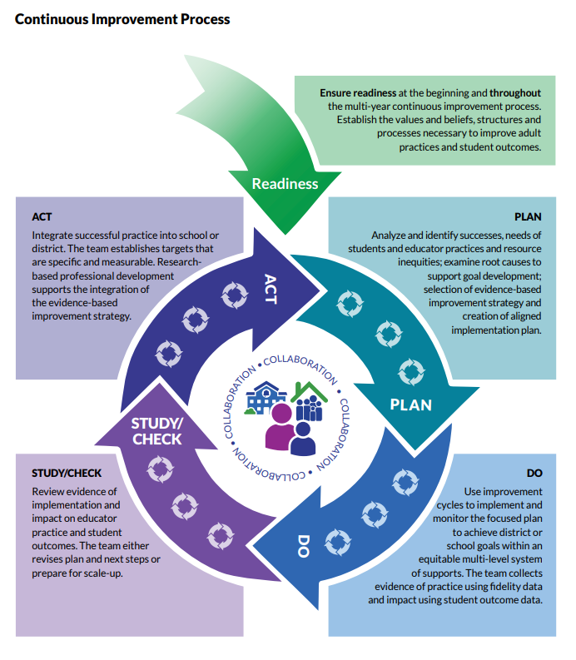
Continuous Improvement
Notes:
This is a graphic of DPI’s continuous improvement process that many districts use to evaluate, plan, initiate, check impact, and act on, using evidence-based improvement strategies.
You can adapt it to help set the structure for your 2-yr Perkins CLNA and application cycle. You have an opportunity to revisit your data and activities formally every two years, but you can do it more often.
It’s always about moving the outcomes needle forward for all students.

Slide 19
Wisconsin’s CLNA Guide
CLNA Training Series
I. Introduction and Overview of the CLNA requirement
II. Focus Area: Performance on Accountability Indicators
III. Career Pathway Evaluation (including LMI and SSQ)
IV. Educator Recruitment, Retention and Training
V. Focus Area: Equity and Access
V. Putting it all together in preparation for the Perkins application
https://dpi.wi.gov/cte/carl-perkins/grants/formula-grants
Notes:
Chris
As we wrap up, I want to acknowledge that what you learn through your Performance on Accountability Indicators analysis, may also inform gaps, root causes and activities in other focus areas as well. Meaning that what you learn could have implications for equity and access, teacher training, etc.
Make notes of this during your analysis and discussions, to come back to and consider again when assessing another focus area or completing your Perkins application.
For example, a gap in the performance indicator: WBL, for a certain population of students, may have been found to be an access issue. Depending on the root cause, you’ll have to decide if the goals and activities to improve WBL data align more with another focus area such as the equity and access focus area or a particular career pathway.

Slide 20
Don’t hesitate to ask
Chris Lenske, Grant Specialist christine.lenske@dpi.wi.gov
Jessie Sloan, Data Consultant jessica.sloan@dpi.wi.gov
Notes:
That concludes this presentation. We’d love to answer any questions that you have.
Contact either Jessie or Chris with questions about this presentation and completing the CLNA.

