Slide 1
Data Based Decision Making: Using your DLM Results

Slide 2
Overview
Reminders about DLM alternate assessments
Overview of the Individual Student Score Reports
How to read each profile
Suggested uses for each profile

Slide 3
Purpose of DLM Alternate Assessments
DLM alternate assessments measure what students with the most significant cognitive disabilities know and can do
Results from DLM alternate assessments are intended to be used for instructional planning, monitoring, and adjustment
Some states use for additional purposes
Notes:
DLM alternate assessments were designed to measure the knowledge, skills, and abilities of students with the most significant cognitive disabilities.
Results from the assessments can be used to inform instructional decision making, including planning for subsequent instruction or monitoring student performance in a specific area.
Some states may also use results from DLM alternate assessments for additional purposes based on their state policies. Examples include high school graduation requirements and teacher evaluations.

Slide 4
DLM Alternate Assessment Reminders
Assessment covers Essential Elements
English language arts and mathematics are grouped in conceptual areas and claims
Claims
Conceptual Areas
Essential Elements
Notes:
Let’s start with a few reminders about DLM alternate assessments. Remembering these features will help you interpret the reports.
Each assessment is based on Essential Elements, which are sometimes called “EEs.” Essential Elements are the grade-level academic expectations for students who take DLM alternate assessments. These expectations are related to challenging college and career readiness standards but with targets for students with the most significant cognitive disabilities. In English language arts and mathematics, Essential Elements are grouped into conceptual areas within four overarching claims.

Slide 5
DLM Alternate Assessment Reminders
Assessment covers Essential Elements
Science are grouped in domains and topics
Domains
Essential Elements
Topics
Notes:
In science, Essential Elements are grouped into domains and topics.

Slide 6
DLM Alternate Assessment Reminders
The blueprint specifies which Essential Elements are available for testing within each Conceptual Area
Each student is expected to test on all Essential Elements in the grade-level blueprint
Notes:
The assessment blueprint lists the Essential Elements available for assessment within each conceptual area. In each grade and subject, a certain number of Essential Elements are made available.

Slide 7
DLM Alternate Assessment Reminders
Each Essential Element consists of linkage levels of varying complexity
Each linkage level has a testlet
Students may take testlets (short tests) on one or more linkage levels per Essential Element
Notes:
Each Essential Element consists of linkage levels. In English language arts and mathematics, there are five total linkage levels, including three precursor levels, which lead up to the Target level, and one successor level for students who have already achieved the targeted grade level skill. In science there are three linkage levels.
DLM alternate assessments are made up of a series of testlets. Each testlet includes items for one or more Essential Elements, all at a single linkage level. Because the linkage level a student tests on adapts between testlets based on his or her responses, different students test on different linkage levels for each section of the test.

Slide 8
DLM Alternate Assessment Reminders
Linkage Levels in an Essential Element
Testlets
Increasing complexity
Notes:
Here is an example of the five linkage levels within a single mathematics Essential Element. Each linkage level is indicated by a box around one or more skills measured at the linkage level, with the Target level indicated in a yellow box. Each linkage level is measured by items on the testlet. As the linkage levels progress, the complexity of the skills also increases.

Slide 9
Key Points
Results are based on student mastery of linkage levels for each EE
Linkage levels are called “skills” in the report
Results are based on all linkage levels – not just the ones tested
Notes:
The score reports you will see in this presentation contain a lot of information about the student’s performance. Here are some things to keep in mind.
First, all of the results you see are based on the student’s mastery of knowledge, skills, and understandings in the linkage levels associated with the Essential Elements. The linkage levels are called “skills” in the score report. Finally, the results are based on all the linkage levels for all the required Essential Elements. Because of the ordered nature of the linkage levels, the scoring system provides information about student performance beyond just the linkage levels the student tested on during the year.
You will learn more about that in a few minutes.

Slide 10
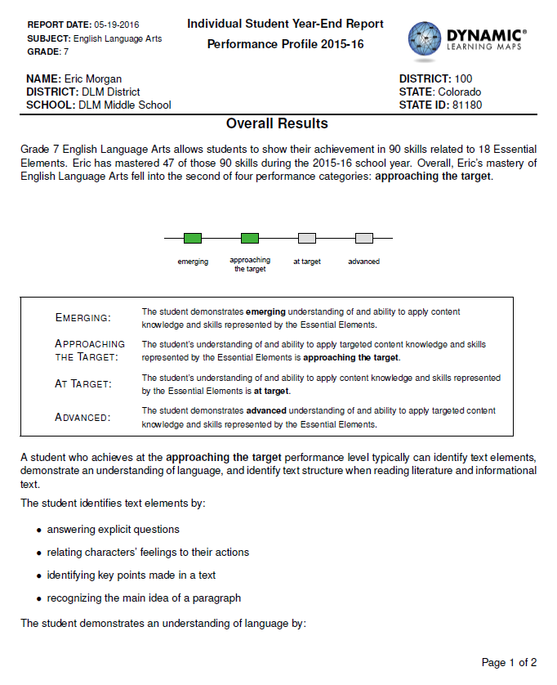
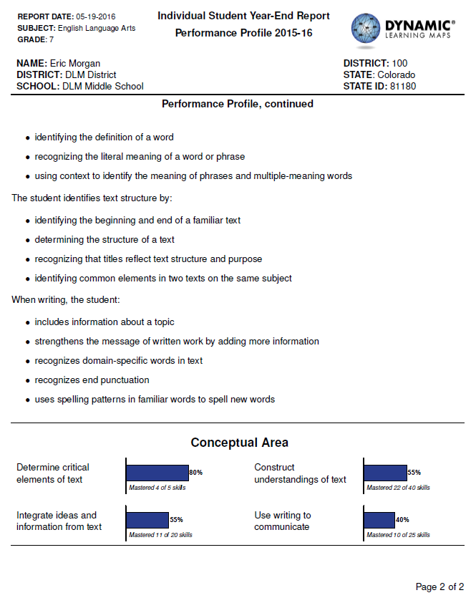
Performance Profile
Notes:
Your student completed the Dynamic Learning Maps alternate assessment last year, and now you’re looking at the results in the Performance Profile. What can you get from it, and what can you do with the information?
Let’s start with an overview of the Performance Profile for our sample student, “Eric Morgan.” This is Eric’s Performance Profile in English language arts.
When reading the Performance Profile, you’ will notice the word “overall” used a few times. This profile presents a broad view of skills and “overall” performance in the tested subject.

Slide 11
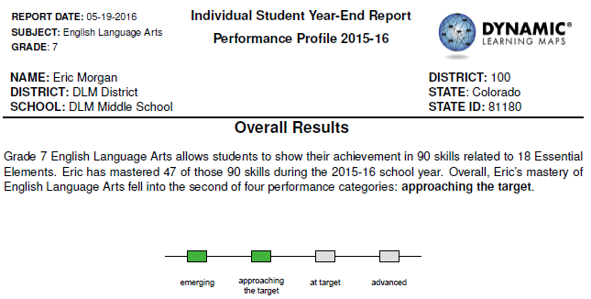
Performance Profile in Detail
18 x 5 = 90
Notes:
Let’s take a closer look at the Performance Profile. This example is for seventh grade English language arts. Below the student’s identifying information, in the section titled Overall Results, the first sentence explains the total number of skills that could be mastered based on the number of Essential Elements required for this grade and subject. Remember that “skills” are interchangeable with “linkage levels” and there are five linkage levels per Essential Element in English language arts. In this example, the student is required to be tested on 18 Essential Elements. Eighteen times five linkage levels equals 90 possible skills that could be mastered.

Slide 12
Performance Profile in Detail
Notes:
The second sentence tells the number of skills the student mastered, overall, in the subject. In this example, Eric mastered 47 skills.
You might be tempted to think of this overall performance as a percent correct – 47 out of 90. But that’s not quite right. Remember that students are expected to test on a required number of Essential Elements, 18 in this example, but they don’t take testlets at every linkage level for each Essential Element. Because of this assessment design, Eric did not necessarily test on all 90 skills.
Let’s stop here and learn more about how “mastery of skills” is determined for DLM alternate assessments.

Slide 13
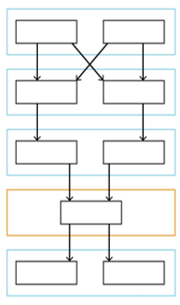
Skill Mastery
Notes:
Remember that for each Essential Element, the skills, or linkage levels, are interconnected, like in the map image shown here. A student’s responses to a testlet at a single linkage level are used to determine whether the linkage level has been mastered.
Because the skills are connected within the Essential Element, we can also make decisions about whether a student has mastered other linkage levels that were not assessed. For example, if a student has mastered one linkage level, there’s a high probability that this student has mastered the skills in all lower linkage levels for that Essential Element.
Like any test score, student results represent the status of their skills on the day the student was tested.

Slide 14
Total Skills Mastered
Add the number of skills mastered across all Essential Elements for that grade and subject
Notes:
Total skills mastered is calculated by adding the number of skills the student mastered for the subject across all Essential Elements and linkage levels.

Slide 15
DLM Performance Levels
Notes:
Once we know the total number of skills mastered in a grade and subject, that number is used to classify each student’s overall performance into one of four performance levels. Performance level information is included next in the Performance Profile.
The Dynamic Learning Maps alternate assessments use four Performance Levels to describe overall student performance in a subject area. Educators from DLM states helped determine how many skills need to be mastered in order to reach each performance level. The number of skills that needed to be mastered for students to score at each performance level varies by grade and subject.
For Emerging: The student demonstrates emerging understanding of and ability to apply content knowledge and skills represented by the Essential Elements.
For Approaching Target: The student’s understanding of and ability to apply targeted content knowledge and skills represented by the Essential Elements is approaching the target.
For At Target: The student’s understanding of and ability to apply content knowledge and skills represented by the Essential Elements is at target.
For Advanced: The student demonstrates advanced understanding of and ability to apply targeted content knowledge and skills represented by the Essential Elements
This framework is consistent with the performance level structure for the general education assessments.

Slide 16
Performance Profile in Detail
Notes:
In this example Performance Profile, Eric demonstrated mastery on 47 skills. Mastering 47 skills in seventh grade English language arts placed his overall performance at the approaching the target performance level. His performance level is named in the third sentence and shown by the green shaded boxes.

Slide 17
Grade/Content Performance Level Descriptors
Notes:
Below the performance levels on the Performance Profile, you will see a brief bullet point list of skills. The skills listed are examples of typical skills mastered by students who achieve at this performance level in this grade and subject. This list does not cover every skill a student at this level might demonstrate. Instead, it provides an idea of the types of skills that are often seen at this performance level. Your student may not have demonstrated all these skills on the assessment and may demonstrate other, similar skills that are not listed.
This information can be helpful in explaining the types of skills commonly demonstrated at a given performance level to parents or guardians. All of the performance level descriptors for each grade and subject are available on the DLM website. The full set of descriptors may help you set goals at the beginning of the year for the student’s performance at the end of the year.

Slide 18
Conceptual Areas
Notes:
In this section of the Performance Profile, you will see each Conceptual Area for the subject. Conceptual Areas are groups of related Essential Elements. The Conceptual Areas can help identify broad areas of strength and need within the subject.
Each conceptual area has a blue bar, a percentage of mastery, and a note listed under the blue bar stating the number of skills mastered and the total number of skills being evaluated.
When looking at the conceptual areas listed on Eric’s Performance Profile, we can see that he mastered 80% of the skills that fall within the “Determine critical elements of text” conceptual area. However, Eric only mastered 40% of the available skills within the “Using writing to communicate” conceptual area. These results could suggest that Eric may benefit from additional instruction and learning goals in using writing to communicate, using the Essential Elements in that conceptual area from this year’s grade.
Remember: Conceptual Areas typically have a different number of component skills. While each bar can go up to 100%, the number of skills that go into the calculation is likely to be different by Conceptual Area.

Slide 19
Suggestions for Using Performance Profiles
Developing IEPs
Communication with parents
Communication with other educators
Notes:
Performance Profiles can serve many uses.
One possible use is Developing IEPs. The Conceptual Areas on the Performance Profile may help describe the student’s present levels of performance and provide some guidance on general areas where you may want to focus student goals. The professional development module on standards-based IEPs, available at dlmpd.com, contains additional information about how to use DLM results during IEP development.
Performance Profiles may also be used to Communicate with Parents. Use the Performance Profile to explain the student’s overall performance in the subject. Explain that the performance is based on expectations for students who are eligible for DLM alternate assessments. Use the conceptual areas to describe the student’s strengths within the subject.
Performance Profiles may also be used to Communicate with Other Educators. There are a number of circumstances in which you may need to communicate a student’s skills with another teacher or administrator. These can include a student transferring schools or classrooms, a student who works with multiple teachers, or reporting a student’s progress or needs. The Performance Profile could be a basis of common and consistent language among educators so the students receive supports and services they need.

Slide 20
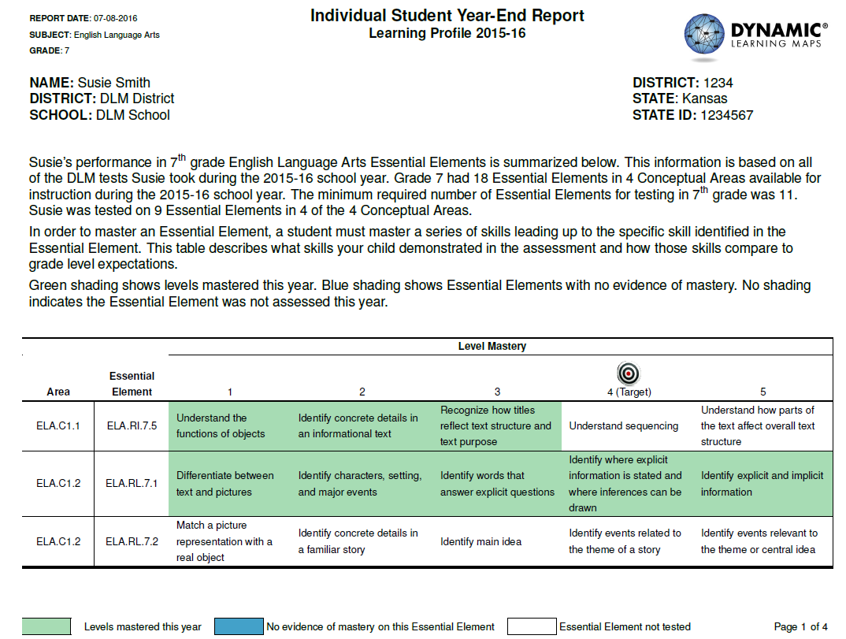
Learning Profile
Notes:
The second part of the individual student score report is the Learning Profile. This profile describes Essential Elements tested, including the skills mastered and not mastered, and the Essential Elements not tested among those available to be tested in the grade and subject. The Learning Profile provides detailed information about skill mastery that underlies the broader summary information in the Performance Profile.
The Learning Profile continues for two or more pages. This is an example of the first page.

Slide 21
Learning Profile
Notes:
The narrative at the top of the Learning Profile outlines the number of Essential Elements and Conceptual Areas tested out of the number expected for the grade level. The first paragraph explains the number of Essential Elements available for assessment and the number that the student actually tested on.
As a seventh grader, Susie was required to be tested on 11 Essential Elements but actually tested on 9.

Slide 22
Learning Profile
Notes:
This narrative also defines the key of the table that starts below the narrative. Green, which appears as light gray on a black and white copy, indicates the student mastered a specific skill. Blue, or dark gray on a black and white copy, indicates the skill was tested but the student demonstrated no evidence of mastery. No shading indicates the skill was not assessed.

Slide 23
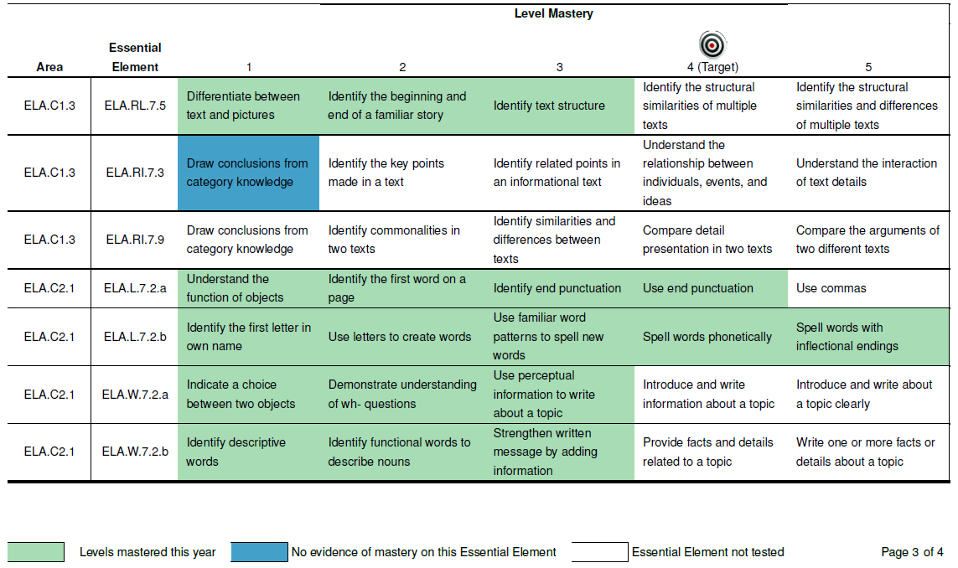
Learning Profile – Elements of the Table
Essential Elements
Levels
Skill
Key
Notes:
Before we look at the results in the table, let’s look at the key parts of the table. Understanding this layout will help you interpret the results.
Each row in the table contains information for one Essential Element. Remember that the blueprint for each content area contains the text of each Essential Element. To the left of the Essential Element code is the conceptual area that the Essential Element falls within.
The columns show and define levels of skill mastery for the Essential Elements. Remember that skills are also called “linkage levels” during the assessment.
The grade-level expectation, or target, for an Essential Element is the fourth skill listed for the Essential Element. The other skills are on the learning path leading up to the target and beyond the target skill.
Each box to the right of each Essential Element code represents a skill. Remember that DLM results are based on student demonstration of mastery of specific skills.
Below the table is the key that explains the shading of skills in the table. On screen the shading is in color, but the shading appears different when printed in grayscale. Green, or light gray, represents mastery of a skill. Blue, or dark gray, represents an Essential Element that was tested but for which the student did not master any skills. White, or not shaded, indicates skills that were not tested.

Slide 24
Skill Mastery
Initial Precursor
1
Understand the function of objects
Distal Precursor
2
Identify concrete details in an informational text
Essential Element ELA.RI.7.5
Proximal Precursor
3
Recognize how titles reflect text structure and text purpose
Target
4
Understand sequencing
Successor
5
Understand how parts of the text affect overall text structure
Notes:
Remember that each individual skill is one of a group of five skills, or linkage levels, within an Essential Element. These skills go in order from least complex to most complex. This is an example of the five levels for the Essential Element ELA.RI.7.5. The skills are identified by their linkage level names: Initial Precursor, Distal Precursor, Proximal Precursor, Target, and Successor Levels. Each Essential Element is structured this way.

Slide 25
Skill Mastery
Initial Precursor
1
Understand the function of objects
Distal Precursor
2
Identify concrete details in an informational text
Essential Element ELA.RI.7.5
Proximal Precursor
3
Recognize how titles reflect text structure and text purpose
Target
4
Understand sequencing
Successor
5
Understand how parts of the text affect overall text structure
Notes:
Earlier we explained that students do not typically take testlets at all linkage levels, but the testlets they take provide information about their mastery of skills for all linkage levels for the Essential Element. Here is how this works.
Remember, if a student is classified as a master of a higher-level skill, then the student is also assumed to be a master of the lower-level skills.
Skill mastery is not based on a number of trials or percent correct results alone; rather, it is based on a probability that the student mastered the skill, given the student’s answers to all of the items about that skill, and other skills within the EE. While skill mastery is based on the best evidence we have available, it’s important to remember that all evidence is from the testlets taken.

Slide 26
Initial Precursor
1
Understand the function of objects
Essential Element ELA.RI.7.5
Distal Precursor
2
Identify concrete details in an informational text
Proximal Precursor
3
Recognize how titles reflect text structure and text purpose
Target
4
Understand sequencing
Successor
5
Understand how parts of the text affect overall text structure
Notes:
Here is the same Essential Element with information about Susie’s mastery filled in. Since Susie successfully answered items at level three, then it is probable that she would also answer items correctly at levels one and two, even though she was not tested on them, so she is considered a master of those skills, as well.
Susie’s score report shows she demonstrated mastery of three of the five skills – Initial Precursor, Distal Precursor, and Proximal Precursor. This graphic corresponds to the first Essential Element of Susie’s Learning Profile. Susie demonstrated mastery of the first three skills (shaded green), so she mastered a total of three skills on this Essential Element. She may or may not have tested at the target and successor levels.

Slide 27
Reaching the Target
Notes:
You have probably noticed by now that there’s a bullseye image above level mastery 4. Target level is the grade level expectation for that Essential Element. To reach the target, students have to demonstrate mastery of the targeted skill. Susie did not achieve at the Target level for Essential Element ELA.RI.7.5., but she did meet (and exceeded!) the Target level for Essential Element ELA.RL.7.1.

Slide 28
Level of Mastery
Conceptual Area
Essential Element
Notes:
The information in the table can be read a few different ways, depending on how you want to evaluate a student’s performance.
Each row lists all the skills associated with that Essential Element. Viewing it this way allows you to look at specific skills and evaluate the student’s performance on a particular Essential Element.
If you read the table vertically, you can review how a student performed at a particular level of mastery across all Conceptual Areas and Essential Elements.
If you are looking for broader trends in student performance, you can look at all the data presented within a particular Conceptual Area, which is a group of related Essential Elements.
All skills where students show mastery are used to determine the student’s overall performance on the assessment for that subject. Remember that evidence of mastery of each skill is based on the student’s performance on the DLM alternate assessment. The student may show skills differently in other situations such as during instruction.

Slide 29
Learning Profile
Notes:
Now that we know what we are looking at in the tables, let’s look at an example. The Learning Profile shows all Essential Elements available for testing at that subject and grade level. Each Essential Element has five levels of skills listed within it. The shading on this report shows where the student demonstrated mastery, lack of mastery, or was not tested.
Notice that the example on this screen is one of four pages of Susie’s Learning Profile.
On this screen, we can see that Susie was tested on Essential Elements ELA.RI.7.5 and ELA.RL.7.1. On ELA.RI.7.5, she mastered three of the five possible skills. On ELA.RL.7.1, she mastered all five of the possible skills, which means she performed above the target level for this EE. Since the third row, ELA.RL.7.2 is completely shaded white, we can tell that Susie was not tested on this Essential Element.

Slide 30
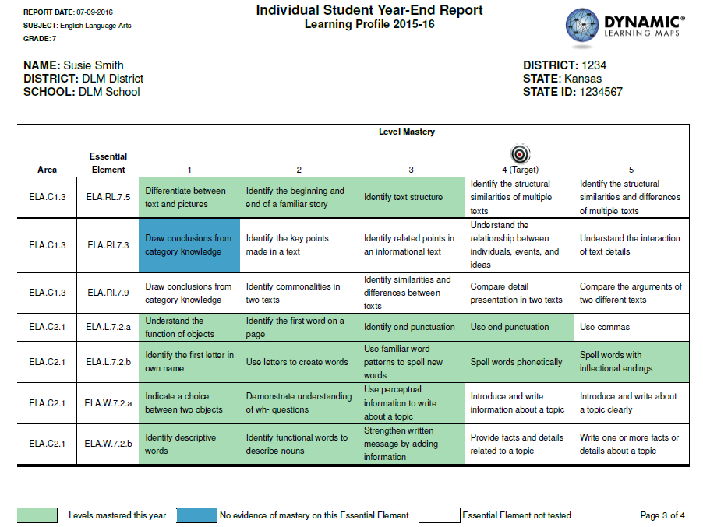
Learning Profile, cont.
Notes:
Here is another page from Susie’s English language arts Learning Profile. On this page, we see results for six tested Essential Elements.
As on the previous pages, all the green shading indicates skills on which Susie demonstrated mastery. The last four rows show the results for Essential Elements in conceptual area 2.1. She mastered skills at and beyond the target for the two Language EEs – 7.2a and 7.2b.
One Essential Element, RI.7.3, is highlighted blue at the lowest level. This blue shading indicates Susie was tested on this Essential Element but did not demonstrate mastery of any of the skills for that EE.
Susie was not tested on RI.7.9.

Slide 31
Suggestions for Using the Learning Profile
Communicate with Parents
Use to explain the Performance Profile
Describe the student’s present levels of performance when developing an IEP or other report
Notes:
We will wrap up with some suggestions for using the Learning Profile.
Learning Profiles can be useful when talking to parents or guardians. After showing the Performance Profile, use the Learning Profile to show specific skills that go with the conceptual areas in the Performance Profile. The Learning Profile may help expand the parents’ understanding and expectations of the student’s academic skills and the grade-level expectations at the Target level for each Essential Element.
Evidence of skill mastery may also fit with other data sources when writing a description of the student’s present levels of performance for an Individualized Education Program or other report.

Slide 32
Suggestions for Using the Learning Profile
Set instructional goals - Connect previous grade’s EEs to current grade
Identify strengths and weaknesses
Guide goal development for a standards-based IEP
Professional development module available at dlmpd.com
Notes:
The learning profile shows skill mastery at the end of the tested grade. But the results can be used to plan for instruction in the next grade’s Essential Elements. Compare the skills in the learning profile, and especially the target level, with the Essential Elements for the next grade level Essential Elements. Those connections across grades may help you identify strengths and weaknesses to be addressed in the new academic year.
Additionally, if a weakness was identified at the Conceptual Area level on the Performance Profile, it is a good idea to check the Learning Profile to determine whether the weakness was due to too few Essential Elements having been tested or low performance on the Essential Elements.
A student’s performance on groups of related Essential Elements may also help you plan IEP goals that support the student’s academic learning.
For more suggestions on standards-based IEPs related to the DLM Essential Elements, see the professional development module available at www.dlmpd.com.

Slide 33
Individual Student Report
Summarizes information from the Performance Profile
Incorporates social studies for students in grades 4, 8 and 10
Easy to print/mail format for parents

Slide 34
Individual Student Report
Consistent with the tables on the performance profile.

Slide 35
Cautions
Results are based on the information from a single assessment
Results are based on best estimates of mastery probability using a limited number of items
Results are not intended to be used to make decisions about retention, placement, or disability eligibility
Notes:
Before we end, let’s review some of the cautions when interpreting student reports.
First, the results show information based on how the student answered items on the DLM alternate assessment. Each testlet was completed in a single setting and for one type of assessment. Students may show their understanding of these academic skills differently when assessed in other ways.
Second, students are judged to be masters of skills based on their response to assessment items. Even when those responses indicate a high probability of mastery, we cannot absolutely say the student mastered the skill. In the same way, when item responses indicate a low probability of mastery, we cannot absolutely say the student has not mastered a skill. Skill mastery on a DLM score report is based on the best estimates of mastery that we have, based on the student’s responses to assessment items.
Third, remember DLM alternate assessment results are intended to inform instructional decision making. Results from DLM alternate assessments are not intended to be used to make decisions about retention, placement, or disability eligibility.

Slide 36
WISEdash
Administrators have access to longitudinal data in WISEdash under Student Profiles
Can use to see trends and compare to state level data

Slide 37
Data Inquiry
What is your district doing?
How does this impact the work you do on a day-to-day basis?
Do you have opportunities to work with content/ general education teams?
Notes:
ESSA and RDA have create a need to look at the shifts and gaps in our data. Outside of race, disability status is our second largest achievement gap in WI.

Slide 38
PLC Data Inquiry Process
What do we need to know about student learning?
Which data best indicate students are learning?
Why?
What targets?
Why did we meet or not meet all student needs?
What data?
How?
How will we adjust our teaching?
Notes:
The WISExplore team has developed a highly structured process for helping districts develop systematic processes when looking at their data. The following slides depicts an example of what the process could look like in a Professional Learning Community.
Each district has their own framework for PLCs. This framework and its protocols should be your guide.
However, this is an example of an inquiry process that could be utilized as a guide for a PLC as they inquire about student data. In special education, we progress monitor based upon student IEP goals. This process helps us to focus on progress overall within a content area and think about larger picture.

Slide 39
Curriculum
What do we need to know about student learning?
What targets?
To what degree do we all understand the guaranteed and viable curriculum for all students and its importance in our PLC work?
Based on our curriculum, what are the learning targets that we expect our students to know and be able to do at this time?
What knowledge, skills, understandings and dispositions will students need to progress toward other learning targets?
Notes:
What targets?
Here we are thinking about the grade level expectations for students in each content area (the Essential Elements). Our IEP goals can be embedded within these grade level expectations, but we are really focusing on broad academic expectations. This slide may be a little scary for some of you with students who have the most significant cognitive disabilities. When we talk about ‘curriculum’ you may be thinking I don’t’ have one. We need to start changing our thinking about academics and opportunities to learn.
I encourage you to work with your curriculum directors and content specialists if you are struggling in developing an alternate curriculum. Often you can take the general curriculum and map to the related Essential Elements.
There are some commercial products that can also help you, but the point is to make sure you are aligning your curriculum to the standards and to make sure that you are covering all of them. The learning profile can help you start to think about areas covered on the blueprint of the assessment. Did my student not master skills because they weren’t taught or because they don’t have the necessary skills yet?
Attainment Curriculum alignment resources…..

Slide 40
Data Collection
Which data best indicate students are learning?
What does achievement of the learning target look look like when students meet performance indicators (knowledge, conceptual understanding and application of skills)?
What data?
What patterns do we see in our data?
Are there achievement gaps between groups of students?
Which students seemed to struggle and which students seemed to excel, based on the data?
How have we assessed these learning targets?
How should we assess the content and rigor of these learning targets?
What data tells us about student achievement of the learning targets?
Do we all have the data in a format for us to study?
Notes:
The Dynamic Learning Maps assessment provided summative assessment data for students, but this is just a once-a-year test. What other information does your district collect? For our students with the most significant cognitive disabilities, what other data sources do we have? This is a common area of struggle for many districts. Share out…
Informal data collection-
Teacher observations
Early literacy screener
District screener/alternate screener
It is possible that at the SLOs is written as such that it may provide you data about student academic group

Slide 41
Looking at the Data
Why did we meet or not meet all student needs?
Why?
Why did our strategies lead some students to meet or exceed the learning targets and others to not meet the targets?
Which specific strategies seemed to have the highest percentage of success?
Why do you think these strategies worked?
What strategies were used to overcome the barriers to learning that some students experience (absenteeism, disabilities, language, etc.) ?
Notes:
Looking at the data, we then need to think about why did some students meet the learning target and others missed it?. This process is one where the Learning Profile again may be beneficial.

Slide 42
Planning
How will we adjust our teaching?
How?
What core instructional strategies will we use to help all students become ready for their next learning?
Which strategies were successful for which learners?
What core instructional strategies will we use if students are ready to move beyond our current expectations?
What core instructional strategies will we use to increase student engagement?
What core instructional strategies will we use for students who haven’t met the expected performance level?
What core instructional strategies will we use to help students apply their learning in different situations?
What more do we need to learn about our core instruction and student learning?
Notes:
Finally, we need to be thinking about how we teach to make sure that all of our students are meeting academic expectations. Try to think about the last slide, what were some of the reasons why our students didn’t meet grade level expectations? Let’s challenge ourselves to only focus on what we can control. We can’t control a student's economic status or absenteeism for example, but we can control how inviting our classroom environment is or the lesson plan. How will we adjust our teaching?

Slide 43
Your Thoughts about PLC Inquiry
What are your observations about PLCs in your schools?
To what degree are they embedding inquiry within their collaborative work?
How can you use the inquiry process in your role as an instructional leader?

Slide 44
Discussion and Dialogue

Slide 45
Thank you
Send Questions to:
osamail@dpi.wi.gov

