Slide 1
Trauma Sensitive Schools and Social and Emotional Learning:
Universal Approaches to Student Wellness
Julie Incitti, MSW, CAPSW
School Social Work Consultant
2019
Notes:
Key systems features
Alignment of two approaches in how to create climates that support all students
developing relationships, approaching children, discipline(restorative practices), engaging families, student voice, staff training and support

Slide 2
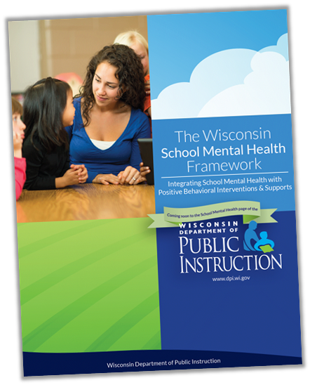
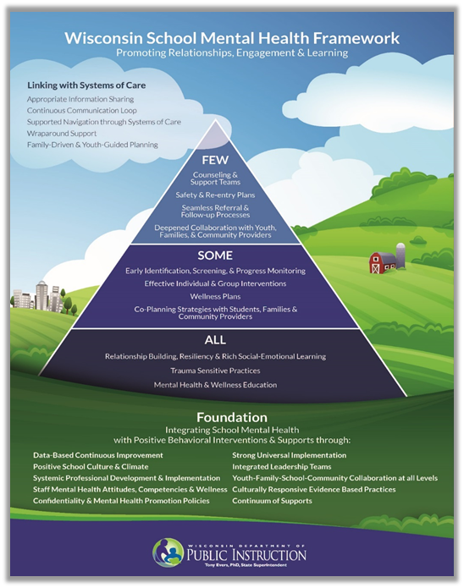
The WI School Mental Health Framework
http://dpi.wi.gov/sspw/mental-health/framework
Notes:
TSS and SEL are part of an effective universal level of school based mental health supports and systems. Student wellbeing includes good social and emotional skills including the ability to manage emotions, focus attention, respect self and others, make responsible choices, and engage with communities. When students and adults apply these skills, we create environments that keep our kids healthy, safe, supported, and encouraged in school every day. A school system that engages in trauma sensitive philosophy and interventions creates an environment that keep our kids and staff healthy, safe, supported, and encouraged in school every day.
Together TSS and SEL provide major pieces of the foundational practices within a school based mental health system of supports, which prepares students for college, career and life success.

Slide 3
The WI SMH Framework: Foundations & Systems of Care
Trauma Sensitive Practices
http://dpi.wi.gov/sspw/mental-health/trauma
Social/Emotional Learning
https://dpi.wi.gov/sspw/mental-health/social-emotional-learning
Resiliency
http://dpi.wi.gov/sspw/mental-health/resiliency
Suicide Prevention Education
http://dpi.wi.gov/sspw/mental-health/youth-suicide-prevention
Culturally Responsive Practices
https://dpi.wi.gov/sites/default/files/imce/rti/pdf/mlss-wi-model-inform-crp.pdf
Notes:
Strong universal implementation relates to relationship building, mental health and wellness education, rich social-emotional learning (SEL), resiliency building, trauma sensitive practices, and collaborative systems and practices which are accessible, effective, and reflective of all. Culturally responsive practices are integral and used by all staff. The universal level is based on high standards and school-wide expectations. Children’s healthy social-emotional development is enhanced by classroom environments and daily interactions with adults who promote the complex learning process toward achievement and wellness.

Slide 4
What We Know About Learning
The brain never stops growing, changing, responding to interaction and environments
Effective learning happens
in caring relationships
when physically and emotionally safe
when sense of belonging, connection, engagement
when opportunities for challenge, failure, and success are plentiful
Individuals learn skills and concepts in different ways at different times
Positive, stable relationships can buffer the potentially negative effects of even serious adversity
(Linda Darling-Hammond and Channa M. Cook-Harvey, Educating the Whole Child: Improving School Climate to Support Student Success, Learning Policy Institute, 2018 https://learningpolicyinstitute.org/sites/default/files/product-files/Educating_Whole_Child_REPORT.pdf)
Notes:
From a Learning Policy Institute report on educating the whole child

Slide 5
What We Know About Learning (cont)
4. Adversity affects learning and the philosophy, policies, and interventions schools employ make a difference
5. Emotions and social relationships affect learning
Interest and excitement increase learning
Fear, anxiety, self doubt reduce learning
Positive social and emotional skills that build on a foundation of empathy and self awareness contribute to relationships, safe environments and learning
6. Learning is increased with hands-on learning, skill practice, goal setting, and a sense of mastery
(Linda Darling-Hammond and Channa M. Cook-Harvey, Educating the Whole Child: Improving School Climate to Support Student Success, Learning Policy Institute, 2018 https://learningpolicyinstitute.org/sites/default/files/product-files/Educating_Whole_Child_REPORT.pdf)
Notes:
*Building a sense of self-efficacy and control by teaching and reinforcing social and emotional skills that help children handle adversity, such as the ability to calm emotions and manage responses; and creating dependable, supportive routines for both managing classrooms and checking in on student needs.

Slide 6
Trauma
Exposure to an event that threatens or harms the physical or emotional integrity of the individual or someone close to the individual
Overwhelms the person’s ability to respond
Creates significant difficulty in functioning Tim Grove, SaintA (2010)
Notes:
Traumatic stress makes it so the brain cannot focus on learning. By giving school staff tools to help students cope with stress, students can again access the educational program. https://www.edsurge.com/news/2018-07-02-integrating-sel-equity-and-trauma-work-for-multiplied-success

Slide 7
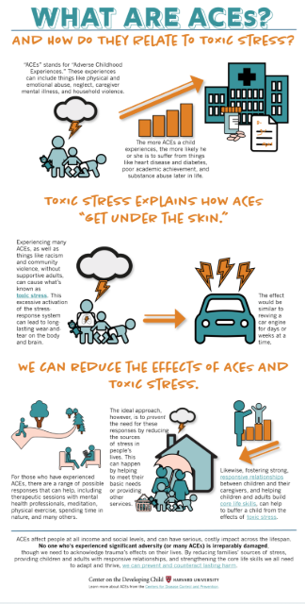
Adverse Childhood Experiences (ACES)
Adverse Childhood Experiences (ACEs):
A term given to describe many types of abuse, neglect, and other traumatic experiences that occur to individuals under the age of 18.
Where did ACEs Come From:
A study in California at Kaiser Permanente by Dr. Anda and Dr. Felitti from CDC
What’s the Point?
Correlation between number of ACEs and negative (physical and mental) health outcomes
Notes:
Children in poverty and/or of color are more likely to experience trauma due to their disproportionate exposure to poverty and violence.
https://developingchild.harvard.edu/resources/aces-and-toxic-stress-frequently-asked-questions/

Slide 8
Children’s Bureau: https://www.childwelfare.gov/pubPDFs/brain_development.pdf
Impacts of Trauma on the Brain
Structural Changes:
Reduced Volume In
Activity Changes:
Changes in neural activity
Functional Changes:
Behavioral Changes
Hippocampus
Learning & memory
Cerebellum
Balance, coordination, executive functioning & emotional control
Prefrontal Cortex
Executive skills
Other structures & metabolism
Amygdala
Assessing threats
Abnormal Cortisol Levels
Too low
Too high
Prefrontal Cortex
Executive skills
Reduced Neural connectivity
Persistent fear response
Hyperarousal
Reduced Working Memory
Impulsive
Increased risk taking
Difficulties navigating social situations
Weakened response to positive feedback

Slide 9
What Is a Trauma Sensitive School?
"Trauma Sensitive Schools (TSS) is an innovation in which schools infuse the core values safety, trust, choice, collaboration and empowerment into their Multi-level System of Support’s practices, assessments and program adjustments.
TSS acknowledges the high prevalence of traumatic exposure for students, the importance of staff wellness and strives to meet the unique needs of all learners.”
Black, P., Cook, E., & Daniel, S. 2017
Notes:
“A trauma-informed approach asks: ‘What happened to you?’ instead of ‘What’s wrong with you?’ or ‘Help me better understand your experience.’”

Slide 10
5 TSS Values
Safety
Trustworthiness
Choice
Collaboration
Empowerment
Notes:
The five core values of trauma-informed care are a foundational component of the TSS professional development system.
.
To plan for and implement trauma-sensitive schools principles and practices it is necessary to understand each of these values. They are the lens through which we view everything that happens in a school including teaching and learning activities, rules and discipline processes, staff and system wellness and all other school policies.

Slide 11
Knowledge to Practice
Trauma Aware School
Trauma Responsive School
Understanding the prevalence and impact of trauma on the school community
Trauma Sensitive School
Beginning to embed trauma responses into student and school level concerns.
A multi-year transformation process that seeks to embed sustainable changes into school culture, policies, practices and procedures
Notes:
The journey towards becoming a trauma sensitive school is one that builds over time—with knowledge, skills and practice. It’s not something that can be completed through one training or one set of strategies. The evolution occurred through intentional and thoughtful planning and hard work.
This is image represents the various stages of becoming trauma informed. A trauma aware school has become aware of the prevalence of trauma exposure and have begun to consider that it might impact their students, families, staff and community. Leadership understands that knowledge about trauma could potentially enhance their ability to fulfill their mission and begins to seek out additional opportunities for staff professional development and growth. Awareness training is offered (including definitions, causes, prevalence, impact, values and terminology of trauma-informed care.) People are made aware of how and where to find additional information, and are supported in further learning. The organization explores what this new information might mean for them and what next steps may need to be taken. Most staff: 1) know what the term trauma refers to; and 2) are aware that knowledge about the impact of trauma can change the way they see (and interact with) others. The impact of trauma is referenced in informal conversations among staff.
A Trauma responsive school has begun to change their organizational culture to highlight the role of trauma. At all levels of the organization, staff begins re-thinking the routines and infrastructure of the organization. Planning and taking action. Begin integration of principles into staff behaviors and practices. Begin integration of principles into staff supports and organizational structures. Staff applies new knowledge about trauma to their specific work. Language is introduced throughout the organization that supports safety, choice, collaboration, trustworthiness and empowerment. The organization has policies that support addressing staff’s initial and secondary trauma. People with lived experience are engaged to play meaningful roles throughout the agency (employees, board members, volunteers, etc.) Changes to environments are made. Organization has a ready response for crisis management that reflects trauma informed values.
Finally, a trauma sensitive school has made trauma-responsive practices the organizational norm. The trauma model has become so accepted and so thoroughly embedded that it no longer depends on a few leaders. The organization works with other partners to strengthen collaboration around being trauma informed. Revision of policies and procedures Implementation of the agency’s model/values is measured for fidelity to a trauma informed model. The organization uses data to inform decision making at all levels. A variety of sustainable training is promoted and made accessible to staff, including at new staff orientation. Ongoing coaching and consultation is available to staff on-site and in real time.

Slide 12
TSS at the Universal Level
School Environments
Social/Emotional Learning
Safety
Trustworthiness
Choice
Collaboration
Empowerment
Emotional and Physical Regulation
Building Relationships
School-Wide Discipline
Academic Supports
Cognitive Problem Solving
Parent Engagement
Staff Wellness
Notes:
The trauma sensitive lens is used to view the behaviors of individuals and also how we integrate the new perspective into our daily work. It is a a way of:
Evaluating all student supports--- programs, plans, individual supports
Evaluating the universal functioning of schools--As a result we…create universally safe school environments, prioritize building relationships between teachers and students, students and their peers, and between teachers, teach emotional and physical regulation, implement social and emotional learning, teach cognitive problem solving alter our school-wide discipline to be positive, restorative and collaborative provide trauma-sensitive academic supports work to increase parent engagement understanding the barriers the parents are facing.
In other words: TSS drives not only what we do, but how we do it
In each of these universal areas we ensure that our programs, processes and activities support the creation of a safe, trustworthy, collaborate culture that supports student and family choice and empowerment. Consider individuals actions by seeking to understand the underlying need

Slide 13
ACE Over the Life Course
Early
Death
Life Course
Disease, Disability & Social Problems
Adoption of High Risk and Unhealthy Behaviors
What Educators Can Do
Social, Emotional, & Cognitive Impairments
Disrupted Neurodevelopment
Adverse Childhood Experiences
Historical/Generational Trauma
Notes:
Generally, efforts to understand matters of public health focus on the top three parts of this triangle – early death; disease, disability, and social problems; and adoption of health-risk behaviors. Educational awareness and intervention target unhealthy behaviors as the cause of disease, disability, social problems and early death. But the ACE study helps us to understand the potential life course for people who experience ACEs. For this, we need to focus on what is underlying the health-risk behavior. The hypothesis is that Intergenerational and historical trauma, along with Adverse Childhood Experiences can lead to impaired neurodevelopment. This in turn can lead to social, emotional and cognitive adaptations that can then lead to the risk factors that cause disease, disability, social problems, and early death. This hypothesis is supported by an emerging understanding of neurodevelopment.
When we look at this pyramid we are compelled to think about the potential impact of eliminating Adverse Childhood Experiences. Think about your community and childhood adversity. Ask yourself, how do we prevent and intervene to reduce adversity?
Click in Arrow
Let’s also think about the role of educators who may have students with social, emotional and cognitive impairments in the classroom. What are the ways in which schools support students to overcome these impairments to potentially alter their life course? What are the universal, school-wide strategies at your school that support social, emotional and cognitive development for students. (Optional Activity/ Discussion of the current strategies)

Slide 14
What is SEL?
Social and emotional learning is the process through which children and adults acquire and effectively apply the knowledge, attitudes, and skills necessary to
understand and manage emotions
set and achieve positive goals
feel and show empathy for others
establish and maintain positive relationships
make responsible decisions.
From: the Collaborative for Academic, Social and Emotional Learning (CASEL)
Notes:
Acquisition and application

Slide 15
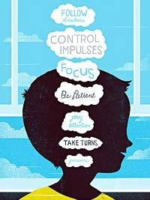
SEL
Social and emotional learning (SEL) enhances students’ capacity to integrate skills, attitudes, and behaviors to deal effectively and ethically with daily tasks and challenges.
CASEL - https://casel.org/core-competencies/
Notes:
social and emotional development comprises specific skills and competencies that students need in order to set goals, manage behavior, build relationships, and process and remember information. Moreover, it is fundamentally tied to characteristics of settings that can be intentionally structured to nurture these skills and competencies….Therefore, it is important for organizations to take a systems approach to promoting development in these areas— addressing adult skills and beliefs; organizational culture, climate, and norms; and routines and structures that guide basic interactions and instruction
https://assets.aspeninstitute.org/content/uploads/2017/09/SEAD-Research-Brief-9.12_updated-web.pdf

Slide 16
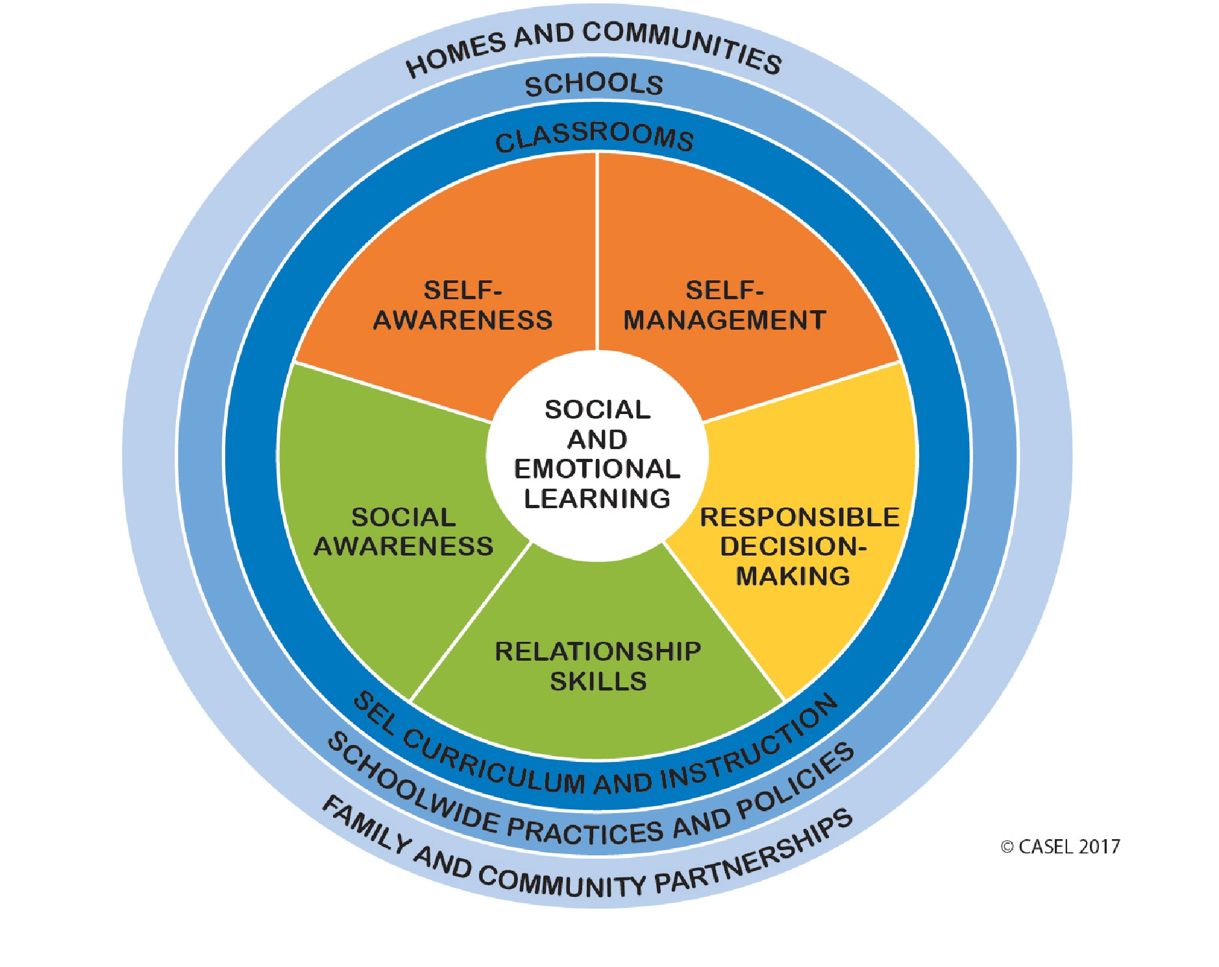
Wisconsin Mental Health Initiative
The 3 Domains Supporting WI Competencies
Emotional Development
Self-Concept
Social Competence
Notes:
These domains are shared with the "Wisconsin Model Early Learning Standards."
While the three domains supporting the Wisconsin SEL competencies are not the same as those identified by the Collaborative for Academic, Social and Emotional Learning (CASEL), all CASEL domains are present in the Wisconsin competencies: Self-Management, Self-Awareness, Social Awareness, Decision Making, and Relationship Skills.

Slide 17
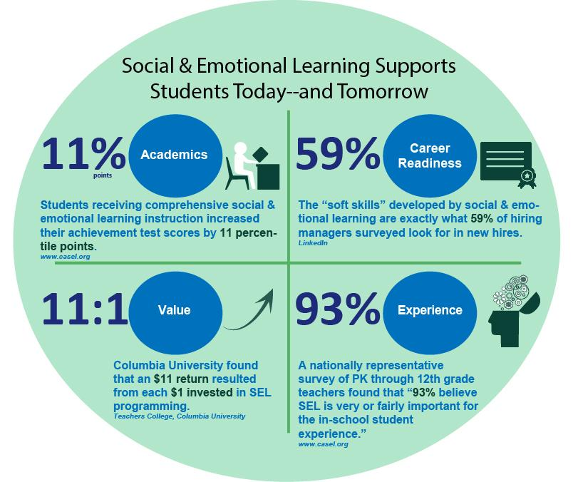
SEL in Wisconsin PK-12 Schools
Helps children:
succeed in school and life
manage their feelings
build healthy relationships
navigate social environments
develop the skills needed to prepare them for the world

Slide 18
Universal Instruction
of Social & Emotional Skills
EMOTIONS
Connect emotions, thoughts and actions
Instruct, model and practice
Reinforce while processing behavior
THOUGHTS
ACTIONS
Notes:
All staff in a trauma-sensitive school are involved in the implementation of social and emotional learning. For students experiencing toxic stress, impacted by trauma, or lacking strong internal developmental assets, it is especially critical for staff to provide consistent and ongoing instruction, modeling and practice of skills.
Classroom teachers, health and physical education teachers, or pupil services professionals may introduce a specific lesson or skill. In academic classes, teachers connect the emotions found in literature, history, and current events to the social and emotional skills the students are learning. Questions can help students to see the connections between feelings, thoughts, and actions in their own lives. Examples include:
“How do you think the character feels in this story?”
“What do you think she is thinking?” and
“How are his feelings affecting how he acts?”
Following unstructured times, such as lunch and recess, teachers guide students through reflective activities about how they acted and what they were feeling and thinking. A chart showing the relationship between feeling, thinking, and acting can be found on page 97 in The Heart of Learning and Teaching: Compassion, Resiliency, and Academic Success, one of the readings for this module. The more connections the instructors make between feeling, thinking, and acting, the more likely all students, including those impacted by trauma, will generalize their learning to situations outside of the classroom.
Staff who address behavior have the opportunity to teach, model, and reinforce social and emotional skills. Students are able to learn to make the connection between their actions and someone else’s feelings, to choose different behaviors that will not hurt others, and to make amends and repair relationships. When staff manage behavior in a trauma-sensitive school, they connect social and emotional learning to the process of building positive relationships. The emphasis is on learning the positive skills, rather than giving a consequence for the negative actions.

Slide 19
SEL as TSS Strategy
Skills to cope with (trauma-related) triggers
A safe supportive learning environment is created when students and staff have good social and emotional skills
A safe supportive learning environment is good for academic learning
Students affected by trauma especially benefit from safe supportive environments
Notes:
SEL can be a trauma sensitive strategy that provides students affected by trauma (and all students)...

Slide 20
SEL as TSS Strategy (cont)
Staff who are able to regulate their own emotions, come from a place of understanding, encourage caring supportive relationships
Skills to increase their ability to access their educational program such as self-regulation, problem-solving,
Skills to develop healthy peer relationships, effective teamwork, and to recognize and respond to unhealthy relationships
Recognizes that executive functioning develops over time and can be taught
Notes:
SEL can be a trauma sensitive strategy that provides students affected by trauma (and all students)...

Slide 21
TSS is Conducive to SEL
All people do well if they can
What happened to you, not ‘what is wrong with you’
Caring supportive adult relationships
Attention to triggers
Provides sense of belonging and purpose
Focus on how we do what we do
Notes:
“A trauma-informed approach asks: ‘What happened to you?’ instead of ‘What’s wrong with you?’ or ‘Help me better understand your experience.’”

Slide 22
Perspective Shift
Instead of | A different look
He’s attention seeking | Why isn’t he getting attention in the way most of his peers do?
She’s avoiding | Many of us avoid when we are emotionally uncomfortable---why is she uncomfortable?
They want control | Why can’t they get their wants and needs met without conflict?
She has a trauma history | If exposure to ACE changes brain architecture, what skills might this person need help with?
He just isn’t motivated | Doing well is preferable—so what’s getting in the way?
Notes:
A way to understand difficult behaviors in students away from blame and labeling the child as angry or aggressive to a child who is suffering and in need of support. Behavior is less a choice and more a reaction to triggers. If we focus on caring connected relationships and helping student regulate their emotions, we can help them succeed.

Slide 23
SEL and TSS - Universal Level
Taught on the universal level - good for all students (school culture and climate)
Internalizers and externalizers
Integrated across settings
Embedded in interactions, instruction, and practices
Consistent opportunity to practice
Developmentally and culturally aligned to the needs of students
Improves school climate, helps manage stress

Slide 24
SEL and TSS Common System Features
Strengths-based - provide a sense of mastery, inclusivity, culturally responsive
Focus on strengthening relationships - staff to student, student to student, adult to adult
Growth-mindset
Proactive rather than reactive
Provide emotional and physical safety for everyone
Focus on the underlying need
Training that aims to change staff behavior and attitudes
Engages in authentic parent/caregiver partnerships

Slide 25
SEL and TSS Common System Features (cont)
Start with leadership team - use existing team, cross-communication, aligned work
Adults are teaching, providing opportunities to practice, modeling, and reinforcing these skills throughout the day
Take time to implement and integrate into the ‘way we do things’
Resilience can be achieved by learning social and emotional skills and by being surrounded by healthy and healing environments on a daily basis
Provide foundation in skills and environment so that more time can be spent on teaching and learning; less time spent on classroom management

Slide 26
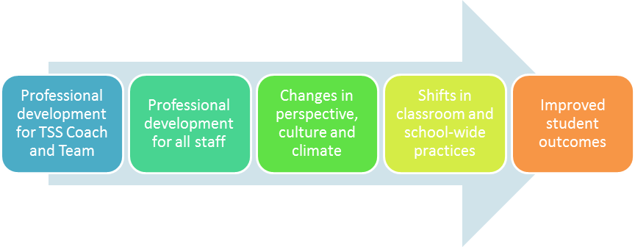
Theory of Change
Professional development for coach(es) and team
Notes:
The continuum above represents our beliefs about how change happens in the journey toward becoming a trauma sensitive school. It is necessary for a school coach and team to enhance their expertise on Trauma Sensitive Schools through professional development. Completing the modules in this learning system will help coaches and teams to develop this capacity.
Then schools must move to professional development for all staff to create universal understanding of trauma sensitive schools. Many teams chose to use some or all of the content to meet the unique development needs of their staff.
Professional development of staff will inspire changes in perspective, school culture and climate. Indicators of this can include conversations about the impact of trauma on students as well as shifts in staff language and perspective on student challenges.
These shifts then lead to changes in classroom and school-wide practice. The modules give many tools to be able to shift this practice including changes in academic and behavioral support strategies, shifts in discipline and changes in the school environment.
All of these changes will result in improved student outcomes in both behavioral and academic areas.

Slide 27
SEL and TSS and Functioning
SEL and TSS can both improve student functioning in areas affected by trauma
Concentration
Problem-solving
Abstract thinking
Working collaboratively in groups
Ability to recall facts
Working memory
Comprehension
Classroom and teacher transitions
Forming relationships
Regulating emotions
Organizing material sequentially
Application of knowledge
Notes:
Acquisition and application

Slide 28
SEL and TSS and Adults
Supports adult mental wellbeing
Adult SEL Skills Are Directly Tied to Our Ability to Be Trauma Sensitive
Teaches skills (problem-solving, mindfulness practices)
Provide philosophy - adults around them give the benefit of the doubt
Offers compassion, reduces stress and burn out
Helps adults recognize own triggers and coping strategies
Enhances classroom management
Effects of trauma and SEL skill competence is not complete by 12th grade. Both are lifelong “projects”. We need to manage our own in order to model and teach students.
Notes:
Adult SEL Skills Are Directly Tied to Our Ability to Be Trauma Sensitive

Slide 29
People Do Well If They Can
Curriculum, interventions & data
External Expectations
Classroom demands
Building renovations
Educator Effectiveness
Internal Expectations
Insert the rest of your life here…
Notes:
The reality of public school education is that it is both exhilarating and stressful. Education is a realm full of organizational and professional changes, expectations, and uncertainties that are often continuous, occurring at an ever-increasing pace, sometimes contradictory, and usually in response to economic, social, and political demands. In our efforts to build resilience in our students, we are charged with the examination of our capacity personally and professionally to model that which we strive to build, and the extent to which our organizational culture and systems support these efforts. An intentional focus on building teacher resilience is both an individual and organizational responsibility and opportunity.
If I continue to lack the capacity to meet others’ expectations or the ones I have for myself because I think I should be able to “motivate” the person I serve to make the changes I expect them to be able to make, it is natural for me to back-up – become apathetic, avoidant, even angry. And we lose the joy of our work.

Slide 30
SEL and TSS and Equity
Equity - each learner as access to the resources and rigor they need at the right moment in their education despite race, gender, ethnicity, language, disability, family background, or family income (CCSSO, 2017)...to develop their full academic and social potential
SEL and TSS contribute to an environment where students are valued for their strengths
Build on strengths to overcome deficits
Discipline that includes philosophy and practices of SEL and TSS can reduce race and gender disparities in the use of ineffective punitive discipline practices

Slide 31
SEL and TSS and Equity (cont)
A student’s sense of how they see themselves impacts their school experience
Beliefs about own learning
Feeling of belonging
Feeling that culture is respected
Is their effort valued
Prioritize the nurturing of caring supportive relationships - students, families, communities
Behaviors understood in context
Outbursts, violence, defiance viewed as externalizing behaviors related to trauma
Agitation, withdrawal, aggression are warning signs of depression

Slide 32
Equity as Access
From Applying an Equity Lens to Social, Emotional, and Academic Development:
Five barriers contribute to inequitable access to a high-quality SEL education
poverty
exclusionary discipline practices and policies
lack of trauma-informed practices
implicit bias in school staff
educator stress and burnout
(Simmons DN, Brackett MA, and Adler N, Applying an Equity Lens to Social, Emotional, and Academic Development, Robert Wood Johnson Foundation, 2018 - https://www.rwjf.org/en/library/research/2018/06/applying-an-equity-lens-to-social-emotional-and-academic-development.html)
Notes:
Pennsylvania state university issued a report titled Applying an Equity Lens to Social, Emotional, and Academic Development in 2018, these are the key findings

Slide 33
Equity as Access (cont)
From Applying an Equity Lens to Social, Emotional, and Academic Development:
Five opportunities identified for overcoming those barriers
school racial and socioeconomic integration initiatives
restorative justice practices for school discipline
trauma-informed system interventions
culturally competent and equity-literate educators
SEL and mindfulness programming to support students and teachers
(Simmons DN, Brackett MA, and Adler N, Applying an Equity Lens to Social, Emotional, and Academic Development, Robert Wood Johnson Foundation, 2018 - https://www.rwjf.org/en/library/research/2018/06/applying-an-equity-lens-to-social-emotional-and-academic-development.html)
Notes:
Pennsylvania state university issued a report titled Applying an Equity Lens to Social, Emotional, and Academic Development in 2018, these are the key findings
Is your SEL program/curriculum being taught in a culturally responsive context?
Does it incorporate and value students’ diverse life experiences?
Does it allow for variations in responses or is one set of cultural norms elevated?
Are students being positioned as the problem, rather than the teacher’s implicit bias/stereotype of groups of children?
Has SEL been introduced into your buildings without changing the curricula, behaviors, and policies that have institutionalized current inequities?
Have staff (not just teachers) received SEL principles and trauma-informed Professional Development?
(from: Mary Fertakis, Social and Emotional Learning and Equity, Power point2017, https://cdn-files.nsba.org/s3fs-public/Presentation_Fertakis_1.pdf)

Slide 34
SEL and TSS and Discipline
Discipline policies and procedures are aligned with SEL and TSS
Clear limits and boundaries are set and enforced
Discipline within the context of continued relationship
Restore the harm, return to the community
Ask what can be learned from the situation - learning moment
Provide rational detachment - it’s not about you(adult)
Consider institutional bias, how behaviors are viewed, how behaviors are punished
Involve natural supports (caregivers, allies)
(video: https://www.policeone.com/police-products/traffic-enforcement/videos/183517519-LAs-favorite-traffic-cop/)

Slide 35
SEL and TSS and College and Career Ready
Manage emotions - recognize triggers
Focus attention - mindfulness
Respect self and others - self worth and value
Make responsible choices - access prefrontal cortex for long term planning
Engage with communities - reduce feelings of fear
SEL skills can be a protective factor to trauma’s risk factors and provides students with skills to take on all types of challenges that may impact college or career readiness

Slide 36
Which to Start With?
Get a team together
Do a comprehensive needs assessment (mental health framework provides one)
Choose one (TSS or SEL) to start
Do a strategy specific needs assessment
Create an action plan to addresses the needs
Provide training to staff and community (coaching, champions, refresher trainings, updates)

Slide 37
Assessing Students
Be careful to avoid deficit-thinking
Don’t say ‘trauma kid’, ‘kid with no SEL’, ‘tier 3 kid’
Identify unmet expectations, specific skill deficits in specific areas - match strengths
Don’t put kids into intervention based on trauma history or SEL issues - id specific needs, triggers, skills

Slide 38
Assessing Students (cont)
Provide supports to students in the universal setting. Use assessments to identify universal instruction
Don’t identify students for tier two support (SAIG groups for example) due to trauma or SEL. Neither SEL or Trauma have psychometrically robust measures for identifying deficits. Identify students based upon behavior. Supports for trauma and SEL skill lags can be PART of the tier 2 supports but shouldn’t be the REASON for them.

Slide 39
Key Takeaways
“Major domains of human development—social, emotional, cognitive, linguistic, academic—are deeply intertwined in the brain and in behavior, and all are central to learning.”
The Evidence Base for How We Learn Supporting Students’ Social, Emotional, and Academic Development: Consensus Statements of Evidence From the Council of Distinguished Scientists https://assets.aspeninstitute.org/content/uploads/2017/09/SEAD-Research-Brief-9.12_updated-web.pdf
Notes:
social and emotional learning and development encompasses cognitive, social, and emotional processes, skills, and competencies. Not only do these important skills facilitate academic learning, but we know that the quality and depth of student learning is enhanced when students have opportunities to interact with others and make meaningful connections to subject material. Promoting social and emotional development includes enhancing the skills that students and adults in schools and in other settings possess and deploy, and depends on features of the educational setting itself, including its culture and climate... It means that social and emotional development is multi-faceted and is integral to academics—to how school happens, and to how learning takes place.

Slide 40
Key Takeaways (cont)
SEL and TSS philosophy and practices...
support each other
implemented at the universal level
for students AND ADULTS
need firm limits and boundaries
must include an attention to cultural responsive practices and equity of access and outcomes

Slide 41
Key Takeaways (cont)
SEL and TSS philosophy and practices...
emphasizes the importance of...
caring relationships
safe, supportive, inclusive environments
sense of belonging
increasing protective factors and resilience for students and staff
need a team to lead and champion
are possible!

Slide 42
Special Thanks
Beth Herman - DPI Consultant
Members of the DPI SSPW Team who work on continuous improvement of the mental health framework adn who have provided content used in this presentation (Elizabeth Cook, Monica Caldwell, Beth Herman, Gregg Curtis, Louise Wilson, Kate McCoy, Elizabeth Krubsack, Kathryn Bush…)

Slide 43
Resources
In-depth Professional Development on Trauma Sensitive Schools, including many of the resources shared today: http://dpi.wi.gov/sspw/mental-health/trauma
Resources and support for School Mental Health in Wisconsin: http://dpi.wi.gov/sspw/mental-health
Wisconsin’s Framework for an Equitable Multi-Level System of Support: https://dpi.wi.gov/rti

Slide 44
Resources
Elizabeth Cook, SEL as a Universal Trauma Sensitive Practice, Powerpoint, 2018
Wisconsin Department of Public Instruction, Wisconsin School Mental Health Project Trauma-Sensitive Schools Professional Development: Social & Emotional Learning Online Module, accessed March 2019, https://dpi.wi.gov/sspw/mental-health/trauma/modules
The Evidence Base for How We Learn: Supporting Students’ Social, Emotional, and Academic Development: Consensus Statements of Evidence From the Council of Distinguished Scientists https://assets.aspeninstitute.org/content/uploads/2017/09/SEAD-Research-Brief-9.12_updated-web.pdf
Mary Fertakis, Social and Emotional Learning and Equity, Power point2017, https://cdn-files.nsba.org/s3fs-public/Presentation_Fertakis_1.pdf
Executive Function, Alberta Family Wellness, video, https://www.albertafamilywellness.org/resources/watch/executive-function
https://www.edsurge.com/news/2018-07-02-integrating-sel-equity-and-trauma-work-for-multiplied-success
Simmons DN, Brackett MA, and Adler N, Applying an Equity Lens to Social, Emotional, and Academic Development, Robert Wood Johnson Foundation, 2018 - https://www.rwjf.org/en/library/research/2018/06/applying-an-equity-lens-to-social-emotional-and-academic-development.html
Linda Darling-Hammond and Channa M. Cook-Harvey, Educating the Whole Child: Improving School Climate to Support Student Success, Learning Policy Institute, 2018 https://learningpolicyinstitute.org/sites/default/files/product-files/Educating_Whole_Child_REPORT.pdf

Slide 45
Questions!
Julie Incitti, MSW, CAPSW
School Social Work Consultant
(608) 266-0963
Julie.Incitti@dpi.wi.gov
Beth Herman, MSE
School Mental Health Training Consultant
(608) 267-9242
Beth.Herman@dpi.wi.gov

